Slide 1

Video in future
不屈号的航海长
July, 2009
Email: 57383971@qq.com

Slide 2

History of H.264
1. Version (May 2003) First approved version of H.264/AVC containing Baseline, Extended, and Main profiles.
2. Version (May 2004) Corrigendum containing various minor corrections.
3. Version (March 2005) Major addition to H.264/AVC containing the first Amendment providing Fidelity Range Extensions (FRExt) containing High, High 10, High 4:2:2, and High 4:4:4 profiles.
4. Version (September 2005) Corrigendum containing various minor corrections and adding three aspect ratio indicators.
5. Version (June 2006) Amendment consisting of removal of prior High 4:4:4 profile (processed as a corrigendum in ISO/IEC)
6. Version (June 2006) Amendment consisting of minor extensions like extended-gamut color space support (bundled with above-mentioned aspect ratio indicators in ISO/IEC).
7. Version (April 2007) Amendment containing the addition of High 4:4:4 Predictive and four Intra-only profiles (High 10 Intra, High 4:2:2 Intra, High 4:4:4 Intra, and CAVLC 4:4:4 Intra).
8. Version (November 2007) Major addition to H.264/AVC containing the Amendment for Scalable Video Coding (SVC) containing Scalable Baseline, Scalable High, and Scalable High Intra profiles.
9. Version (January 2009) Corrigendum containing minor corrections.
Planned additions:
Amendment containing Multiview Video Coding (MVC) - not yet completed; first draft approved October 2008, second draft approved February 2009.[1]

Slide 3
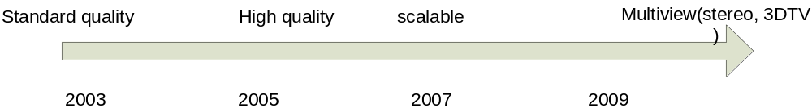
We always seek for the better multimedia experience
From draft, Recommendation to practical product, it will spend 3-5 years. And it needs much effort from scientists and engineers.

Slide 4
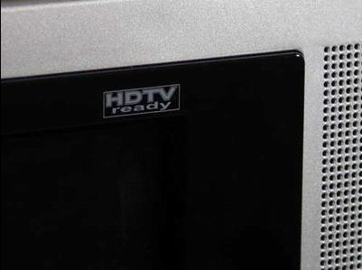
High quality video
High quality (for high definition TV) means not only larger resolution, but more colorful chroma signal(4:4:4, RGB) and finer quantized degree(10 bit).

Slide 5
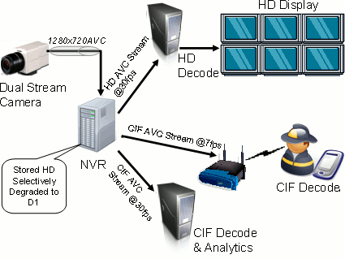
Why we need Scalability
To serve different needs of different users with different displays connected through different network links by using a single bit stream, i.e., a single coded version of the video content:

Slide 6
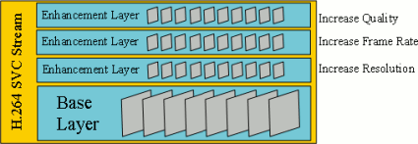
How to Scalability
Spatial scalability: Choose appropriate resolution
Temporal scalability: Choose convenient frame rate
Quality scalability: Choose suitable data rate by removing parts of the bit stream
by removing parts of the bit stream[2]

Slide 7
Benefit from Scalable Video Coding (SVC)
Adaptive streaming
cope with the heterogeneity of networks and devices, play an important role during the transition form SDTV to HDTV.
Error resilience
Decoder restore packet loss by inter and inter-layer information.
Storage management
smaller size than simucast, save space in storage driver, improve IO efficiency.

Slide 8
RTP Payload Format for SVC Video
This Draft is being developed by IETF.[7] It extent rfc3984(for H.264/AVC) to adapt the new functionality of SVC.
single session transmission (SST) and multi-session transmission (MST) are defined in this document, and it indicates the important issue of RTP and SDP, for example, payload format, packetization, de-packetization process and payload parameter etc.

Slide 9
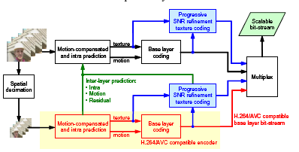
Structure of SVC
A two layer example

Slide 10
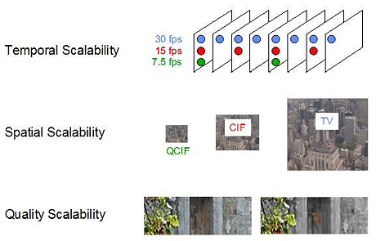
An direct effect of SVC
[4]

Slide 11
Application
The following video applications can benefit from SVC:[5]
Streaming
Conferencing
Surveillance
Broadcast
Storage

Slide 12
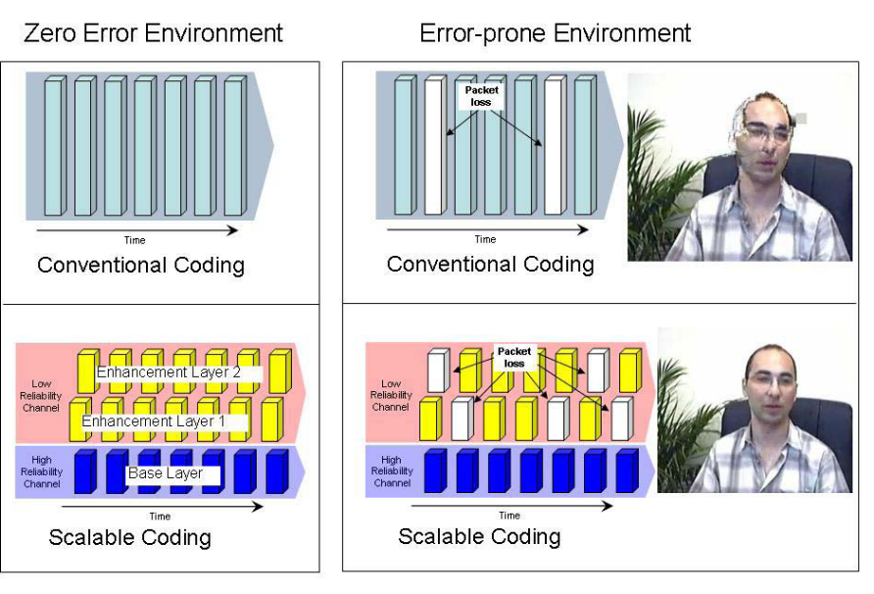
Practical example of Vidyo
They develop svc in their videoconferencing system over IP and 3G network. They try to provide low delay and resilient communication system. They discuss the advantage of SVC in a fluctuant network condition in [3].

Slide 13
Streaming server base SVC
A streaming server base SVC will simplify the work to parse stream, it can dedicate to handling RTP/RTSP session.
Strong adaptive streaming function to the heterogeneity of networks and devices will just depend on a mechanism by judging the header of NAL.
Size of VOD files are less than simucast, and improve I/O efficiency.

Slide 14
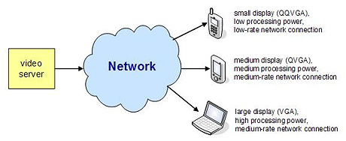
Possibility for more service
Server will manage bandwidth, storage and CPU capability in more efficient way, so that it can serve for more clients and more classes clients at the same time.
Graceful degradation Bit-rate adaptation
Format adaptation Power adaptation

Slide 15
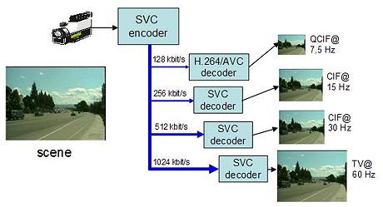
Reduce reconstruction
Reconstruct video in Encoder site will depress its quality. SVC can reduce the possibility to reconstructing since it had provided various sources of programs. Encode once, serve many

Slide 16
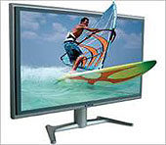
Stereoscopic, 3DTV
An brand-new video technology will bring more on-site user experience. Stereoscopic video will show a vivid scene.

Slide 17
Main participants in H.264/MVC
• JVT
• HHI
• Nokia
• Philips
• Thomson
• Microsoft
• Motorola
• Mitsubishi
• NTT Corporation
• Samsung
• LG Electronics
• Sharp
• KDDI
• Qualcomm
• KHU
• Sejong University
• KETI
• GIST
• Yonsei University
• USC
• Huawei
• Nagoya University
• Victor Company of Japan
• Poznań University ofTechnology

Slide 18
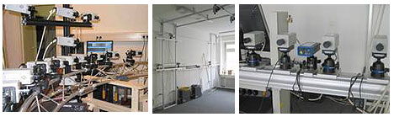
How capture Stereoscopic video
Circular camera configuration (left) camera dome (middle) and linear camera setup (right) in HHI, they capture the samples from different view and get 3D information in the scene.

Slide 19
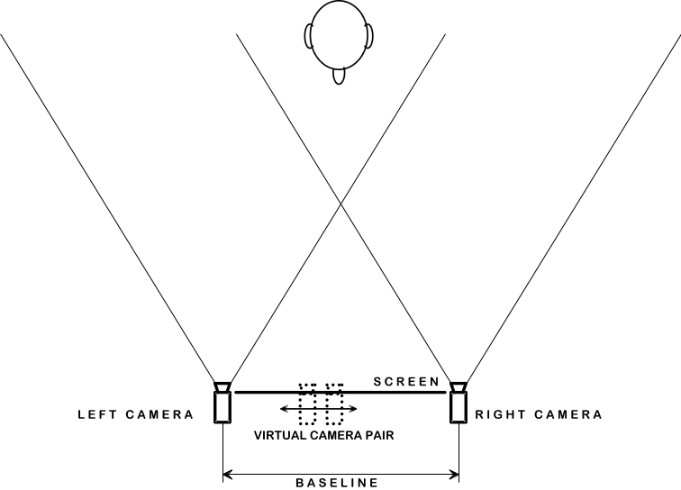
Multiview video coding (MVC)
It will encode the video sequence by the H.264/MVC and depend on inter and inter-view prediction to improve encode efficiency.
There are correlation not only in spatial
And temporal, but in different views.

Slide 20
Key technology of MVC
Illumination compensation
Depth extraction
3D Rendering/synthesis
Inter-view prediction on Motion and Disparity Compensated Coding

Slide 21
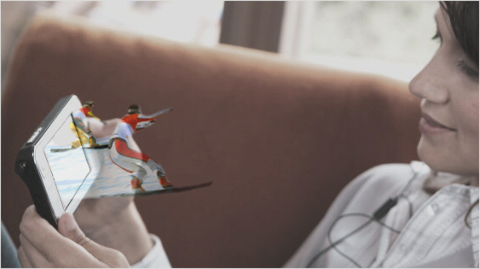
Practical example of Nokia
[6]
They will dedicate in development of codec of H.264/MVC. And the new mobile phone will provide a 3DTV service. And they think, MVC provides superior network robustness and compression performance for delivering 3D video by e.g. taking advantage of the inter-view dependencies of the different visual channels. In addition, its backwards compatibility with H.264/AVC codec makes it widely interoperable in environments having both 2D and 3D capable devices.

Slide 22
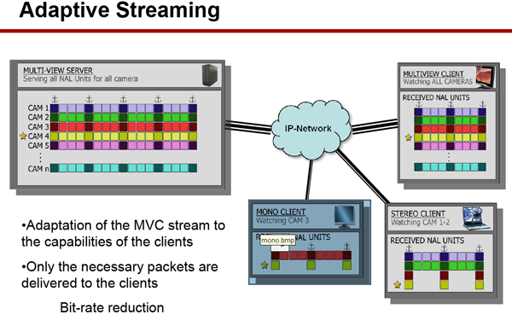
Practical example of streaming server in Technique University Berlin
Flexible communication mechanism is implemented on the view point,
The format of RTP payload should be discussed continuously.

Slide 23
REFERENCES
[1] http://en.wikipedia.org/wiki/H.264
[2] HHI, “H.264 / MPEG-4 SVC”
[3] vidyo, “INTERVIEW WITH DR. THOMAS WIEGAND”
[4] HHI, “http://ip.hhi.de/imagecom_G1/savce/”
[5] Wikipedia ,http://en.wikipedia.org/wiki/Scalable_Video_Coding
[6] Nokia, http://research.nokia.com/research/mobile3D
[7] S. Wenger …,“http://tools.ietf.org/html/draft-ietf-avt-rtp-svc-18”

Slide 24
Welcome to mail me
if you are interested in video technology
Email: 57383971@qq.com

